Slide 1
Engaging employers and negotiating customised position for young job seekers with disability
May 5th, 2023
Sara Murphy

Slide 2

Customized Employment re-frames how we see job seekers with disabilities and how we approach and partner with employers..

Slide 3

Starts with Reframing How We See the People we Serve
Focus has been on Disabilities, what is wrong or broken
Instead of what is meaningful. What defines this person?
What are their passions, skills, strengths and life experiences
Advantage Thinking

Slide 4

Reframing ROY
What his file said:
Attention deficit
Developmental disability
Bombed out of 3 work programs
Can’t sit still or focus
Late – constantly calling in sick
Bad attitude, aggressive, violent
Limited academics, can’t read or write, no computer skills,
What we said:
Active guy
Very outgoing
Likes to move
Loves variety
Can match numbers and use site words
Loves expensive cars
Notes:
HOW DID WE GET THERE?
Person-centered planning with a purpose
Focus on preferences and what a person can do
Shifts emphasis to adding value
Targets businesses where job seeker’s unique characteristics and skills will be assets
The Tornado
Roy working at a car wash where they do detailing for Pacific Heights residents – very high end cars. Chauffeurs would bring cars in. Roy works on the outside of the cars, but also gets to sit inside them while cleaning the inside.
When he interviewed, he hit it off right away with the owner – talking about luxury cars.
Divisidero Touchless Car Wash
So how do you come up with a job that hits the mark – motivates, right amount of activity, uses person’s strengths?

Slide 5
What’s a good job for Roy?
Use VENN diagrams to target employment settings based on candidate’s unique characteristics.
Fast-paced, lots of variety
No desk jobs. Loves to work with his hands
Loves cars- “Nice cars, not Fords”

Slide 6
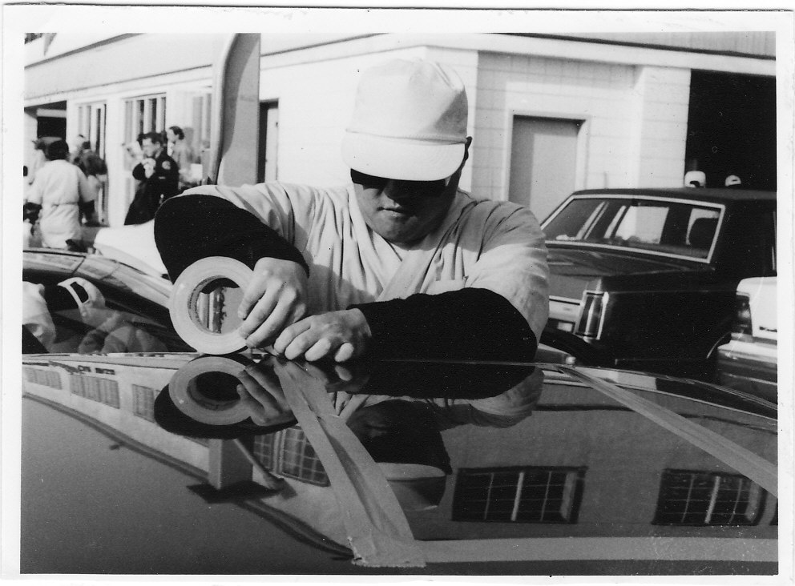
Employee of the Year
Divisadero Car Wash
Notes:
Can’t focus
Can’t work
Cleaning and hated it.
A number of jobs – ended disasterously. Hit someone.
Liked the paycheck – had some motivation but giving up
Lost interest - Because of his experience and getting into trouble – he was very hesitant
Need to find something that would get his interest and motivate him.

Slide 7
Why was Roy Successful?
Job matched not only his skills but also his interest & aspirations
Roy has skills (or attributes) the employer valued and a passion for the business
Job developer found an employment setting and job tasks that matched Roy’s skills and interests, and minimized his disabilities
Job developer was able to demonstrate how hiring Roy would add value to the business and address a workflow issue.

Slide 8
Employer Engagement
Reframing how we approach and partner with business

Slide 9
Help Wanted
Company looking for individual with developmental disabilities, autism and/or history of aggressive behaviors. Extensive history of hospitalization preferred. Social challenges and anxiety, okay. Supportive co-workers. Dance party and movie day on Fridays
Call for an application.
Notes:
Employment is not about what is aberrant
or broken, or what needs fixing-
It is about adding value
We need to see Disability as
“Human Variance”
We need to identify what a job seeker’s can do– the job seeker’s strengths and interests

Slide 10
No more “Selling Disability”
“Untapped labor pool”, “Hire the Disabled”, “Give him a go.” (Deficit Marketing)
Focus is on Job seeker’s skills , not tax credits or employer stipends
Customized Employment is not “job carving”. It is building jobs based on the employer’s needs and a job seeker’s strengths.
We must stop stigmatizing our candidates!

Slide 11


With Customized Employment,
We Must Switch Hats
We must stop selling “disability” and start selling “customized business solutions”
Social Worker
Employment Consultant

Slide 12
What’s Your
Elevator Speech?
What do you say
when someone asks, “what do you do?”
Notes:
Assign Homework.

Slide 13
Effective Elevator Speeches
Are Short. An elevator speech is NOT a sales pitch. Think 3 to 4 sentences!
Use Everyday Language. Avoid our jargon or sounding like a salesman
Start a Conversation. Ask a question of your listener. A successful elevator speech is when the other person says “Interesting. Tell me more.”
It is not about “Disability”

Slide 14
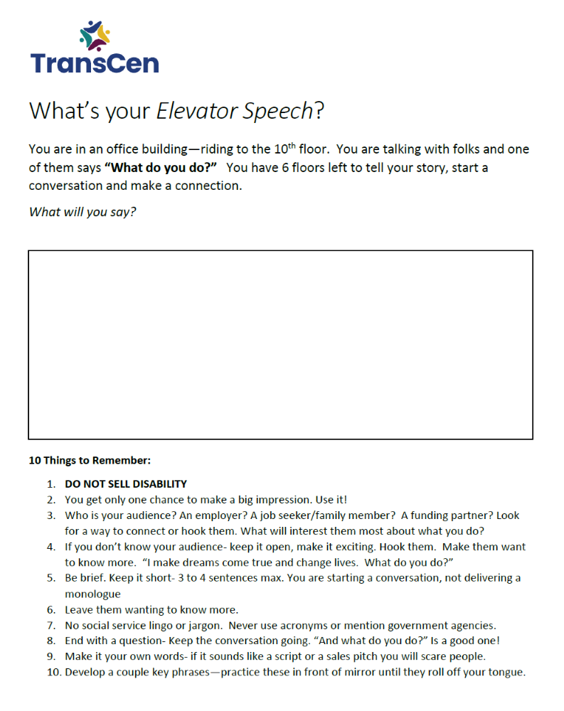
Write Your
Elevator Speech

Slide 15
Use Positive Language and Business Terminology
Look at your program’s branding
No social service lingo or acronyms
“Systematic , routine tasks”, “entry level” vs. “easy, menial jobs” or “repetitive work”
“Recruit and screen candidates” vs. “job development”
Business tools and principles (i.e. Lean, Six Sigma)
“Orientation and training” vs. job coaching
Tools vs. accommodations

Slide 16
Advantages & Benefits for Employers
Cost effective way to improve workflow and reduce waste
Supports core staff so they can concentrate on key aspects of their positions
Productive, dependable, loyal employees
Reduces recruitment and training costs for support positions
Diversifies the workforce
Leverages resources of employment service to assist with orientation and training of the new employee.

Slide 17
Targeting & Networking
Learning about business needs and
building relationships with employers

Slide 18
Target Potential Employers
Use Venn diagrams to target employment settings that will fit like a glove.
Ideal Setting
Interests
or Passions
Talents and skills

Slide 19
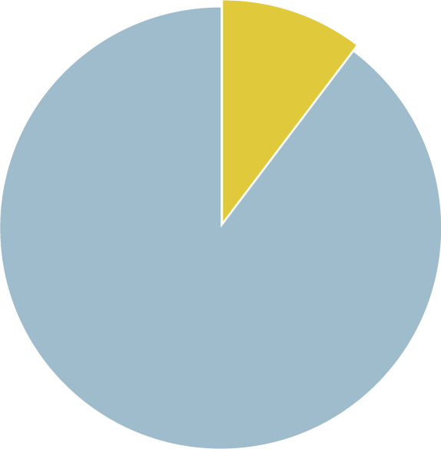
Why is networking so important?
80% of job seekers only apply for posted positions.
But, only 20% of
jobs are ever posted.
20%
Network
20% posted
80% of jobs of Jobseekers apply for jobs via postings
80% of jobs are NOT posted
Notes:
Businesses Have Needs, Get Them Before a Position Has Been Posted

Slide 20
Employer Relationships
Jobs
Prospects
Contacts

Slide 21
Getting from “Contact” to “Job”
Build a relationship with the employer
Learn how the business works and the employer’s needs and challenges. Can your job seeker help address these needs? (“Prospect”)
“It’s the perfect place!” Present your ideas, solutions and candidate (“Negotiate Jobs”)

Slide 22
Informational Interviews
Talk to employers to learn about their businesses

Slide 23

What do Employers Value when Hiring?
Motivated employees who are excited about their work.
Candidates with skills sets that can add value to their workforce.
Business solutions that improve the company’s productivity and/or work processes.

Slide 24
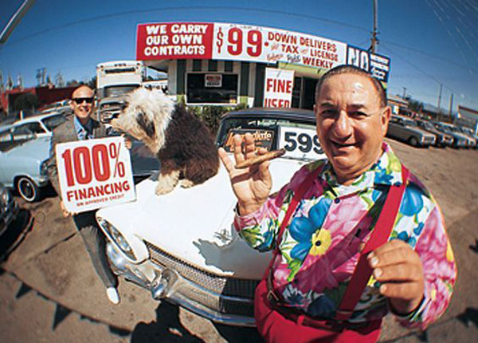
Marketing vs. Selling
Employment Consultants must talk with employers to identify business needs, not pitch the program
or a job seeker

Slide 25
How Do You Get in the Door
Find a “warm”, not “cold” contact
Do not lead with “I work with people with disabilities”
A good opening line…
  “I work with job seekers interested in your industry. My Friend, Mary Smith, said you are an expert in the field and might be able to help me.”
Elevator Speech for your organization.
  “Who are you with? What does your organization do from the perspective of an employer?” (Do NOT sell disability)
Make your initial request easy…
  “Can I come see what you do and talk to you about the skills sets needed to work in this field.”

Slide 26

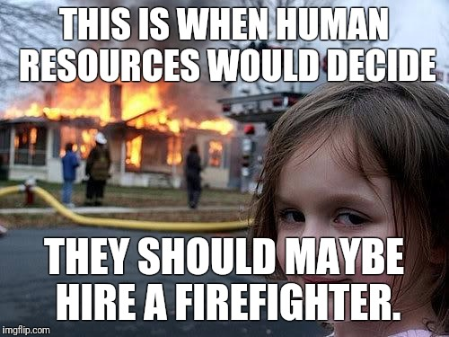
The “Right Person” May Not be Human Resources
HR is responsible for the bigger picture (strategy, projections, policies) and recruiting, on-boarding & managing staff
HR’s role is not necessarily understanding the nuances of the work being done.
HR is often the last to know that there are staffing needs in a department
Customizing Jobs is about Process Improvement
We need to talk to the people doing the work.

Slide 27
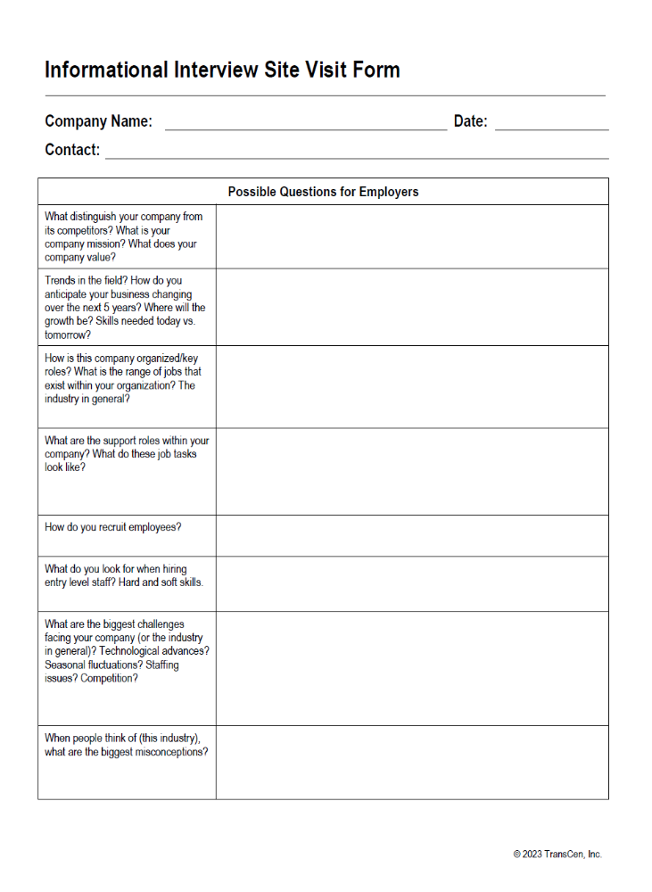
Do your Research
Identify Questions to ask.
Ask for a tour.
Notes:
Identify key products/services
Critical positions (Who are the “rain makers”?)
Look at company culture and values
Is the company growing? Merging? Shrinking? Start-up? Trends in the industry?
Who are their competition– what sets them apart?
Recent events? (good and bad)
Who might you talk with?
Y can we help employer to...
Increase workforce effectiveness and efficiency?
Fill gaps in the workplace?
Reduce costly or inefficient temporary help and overtime wages?
Increase customer satisfaction?

Slide 28
Lean Principles
A Job Developer’s Toolkit

Slide 29
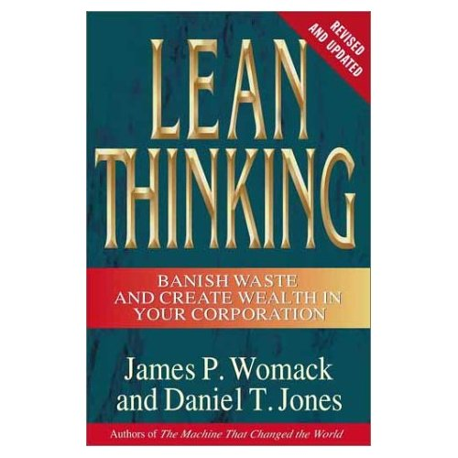
Lean Principles:
A Job Developer’s Toolkit
A process improvement approach that focuses on the customer and seeks to identify “WASTE” and inefficient processes
Learn to talk the language of business

Slide 30
The Toyota Way:
Lean Key Principles
Focus is on the customer’s experience and process improvement
Goal is to identify Value-Adding services and eliminate waste to create “on-demand service” and one-piece “flow”
  Remove Waste: Take out the rocks and the stream will run more swiftly
  To work smarter, not harder
Notes:
Lean seeks to improve the process– by eliminating things that get in the way of doing the important work.

Slide 31
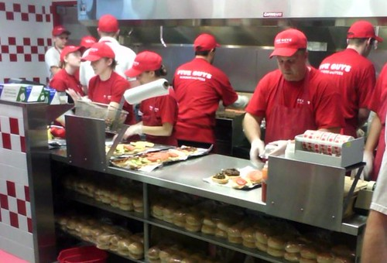

Lean in Action: Fast Food
Have it your way
Orders on Demand
Streamline processes

Slide 32

Lean: 8 Types of Waste
Correction
Overproduction
Motion
Material movement/transport
Waiting
Inventory
Processing
Underutilization of people
Hand out: Examples of Waste for Job developers

Slide 33
During Informational Interviews: Look for “Waste”
Wasted Talent
  Identify who are the “surgeons” (aka highly paid or income-generating staff) Are they doing surgery?
  What are the set-up and button-up tasks for supporting the essential work?
Wasted Time
  Orders not processed because too busy taking new ones
  Machines/supplies not maintained- work stops
Wasted Resources
  Inventory- supplies never used or too much of what is needed
  Overproduction- 50 kits - we ordered 1,000.. expired, obsolete.
  Is the employer using temporary workers? Paying overtime?

Slide 34
Identify ways to streamline processes and improve workflow
What is the product (or service)?
  Are there ways to make product faster or service better?
  Are there ways to make product cheaper or save money?
  Are there ways to increase the number of customers served or improve the customer experience?
  Are the customers (and staff) happy?
      Costs $.80 to keep a customer and $3.00 to
      make a new one
      Costs $5-$10k to hire and train a new employee

Slide 35
Identify Issues/Challenges
Customer /employee complaints
Log jams/backlogs/long lead times/Waiting
Unassigned, but critical tasks
Burn-out or high turnover
Managers or key staff pulled away from core tasks
Workflow fluctuations
  Rush times, crunch times, seasonal fluctuations, sporadic- but important tasks that are not getting done

Slide 36
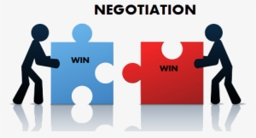
Negotiating a New Position
Present your ideas & solutions
Assist the employer to understand how customizing a job will benefit the business
Help organize the new position.

Slide 37
A Customized Process
Creating opportunities for Stephen

Slide 38


Meet Stephen
Finding Jobs that “fit like a glove”

Slide 39
Reframing Stephen
What his file said:
Cornelia de Lange syndrome
Stutters
Emotionally immature
Gastric Esophageal reflux disorder
Resistant to new things
Perseverates/OCD
Late, attendance issues (esp. when anxious)
Limited academics, 3rd grade math, 2nd grade reading comprehension
What we discovered:
Adventuresome, likes maps, finding places using GPS
Follows the rules
Collects patches
Rides a bike
VERY organized
Hard worker (only when motivated)
Emails friends, Loves “googling” the internet
Loves “disasters”, monitors a police scanner

Slide 40
What’s a good job for Stephen?
Disaster preparedness, safety
Use VENN diagrams to target employment settings based on candidate’s unique characteristics.
Maps and Public Transit
Helping or directing
People

Slide 41
What’s a good job for Stephen?
Organizing things
Use VENN diagrams to target employment settings based on candidate’s unique characteristics.
Likes Technology & “Gear”
Police, 1st Responders

Slide 42
Presenting Solutions:
Potential Tasks Lists
Gets the employer thinking--and talking about tasks (vs. job postings)
Speak the employer’s language
  Use employer’s jargon and organizational terms
List specific job tasks (doing what for whom?)
  not general statements like “file”, “photocopy”
List most important tasks (needs) first
  Which tasks will have the greatest impact?

Slide 43
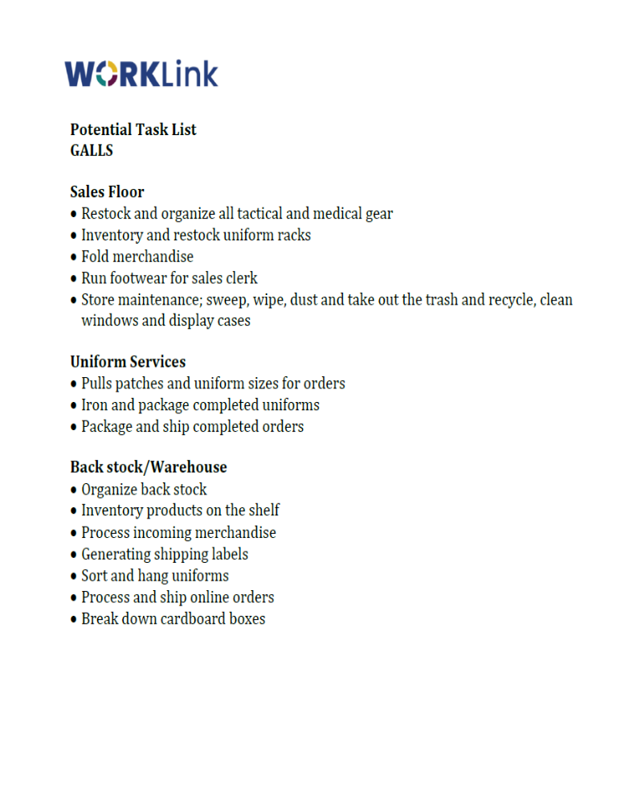
Potential Task List for GALLS

Slide 44
Close the deal
Cost-Savings Analysis
Estimates cost savings by not using a highly trained staff person to do “set-up”/“button-up” tasks (routine, entry-level, support tasks)
Only included when customized job position will help get the work done in a less expensive way
Projects costs/savings over 5-year period to demonstrate additional savings due to Cost-of-Living Adjustments (COLA)

Slide 45
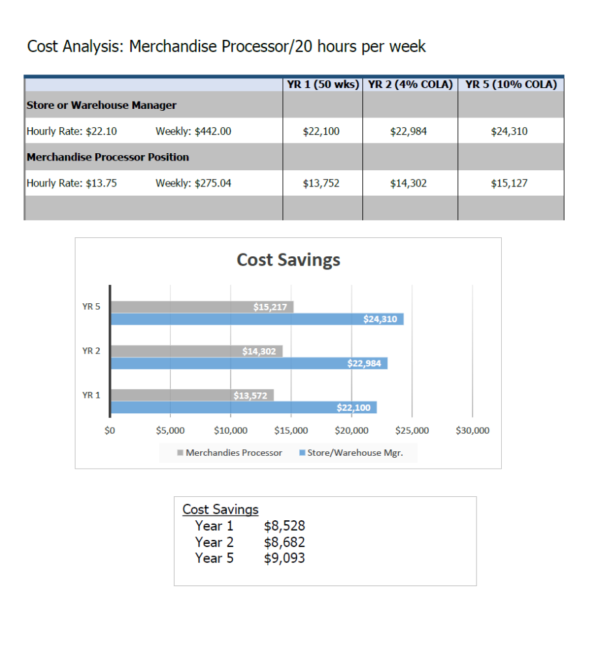
Cost Savings Analysis for Galls

Slide 46
“Here’s the Perfect Candidate”
Use a professional looking resume, tailored to your negotiated tasks
Focus conversation on job seeker’s skills, not deficits
Translate the candidate’s “features” into “benefits”
Hiring your candidate is a solution to an employer’s problem. This is not about charity- or giving someone a chance

Slide 47
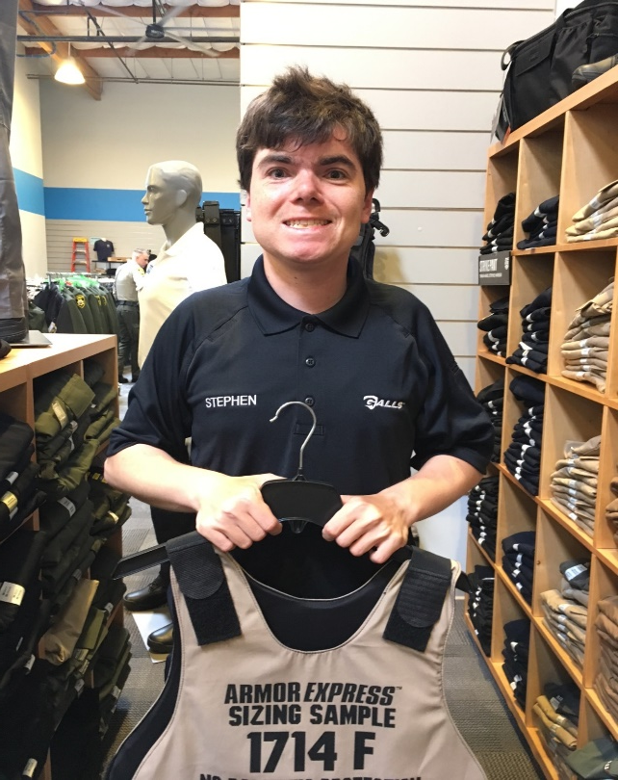
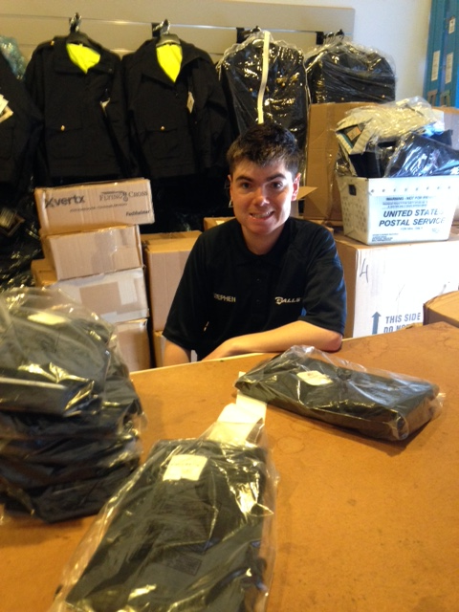

Stephen at
Notes:
Can’t focus
Can’t work
Cleaning and hated it.
A number of jobs – ended disasterously. Hit someone.
Liked the paycheck – had some motivation but giving up
Lost interest - Because of his experience and getting into trouble – he was very hesitant
Need to find something that would get his interest and motivate him.

Slide 48
“We’re not hiring” to
“When can he start?”
Stephen has skills and attributes the employer valued
He is extremely interested in the business
  “He’s one of us”
  Minimizes disability
Job developer identified needs and presented a cost effective, solution to the employer’s problems
Job developer helped the employer understand how to utilized Stephen’s skills and accommodate his disabilities

Slide 49
For More Information:
Sara Murphy
785 Market Street, Suite 670
San Francisco, CA 94110 USA
415.979.9520 (office)
415.225.2187 (cell)
smurphy@transcen.org
Michelle Wakeford
The Brotherhood of St Laurence
Senior Manager Youth Transition Disability
Phone 0482 182 083
Michelle.Wakeford@bsl.org.au

Slide 50

About TransCen
TransCen, Inc. is a national organization offering web-based and in-person training for state agencies, school districts, provider organizations, and others interested in meaningful work and community inclusion for individuals with disabilities.
Learn more about our work: www.transcen.org
Contact us at inquiries@transcen.org for more information!

